Slide 1

Research on Remote Sensing Applications in Malta
Massimo Darmanin
Institute of Information & Communication Technology
MCAST, Paola, Malta
Notes:
Hi, my name is Massimo Darmanin and this is my research on remote sensing applications in malta.

Slide 2
Problem Definition
Maltese Urban population grew from around 91.7% to just below 95% in 2018 and is increasing each year*.
Population growth and economic development led to an increase in demand for housing and other amenities.
These and other causes contributed to the phenomena of urban sprawl, particularly in rural areas.
*https://data.worldbank.org/topic/urban-development?end=2018&locations=MT&start=1998
Notes:
Population growth and economic development lead to an increase in demand for housing and other amenities.
This has led the maltese urban population to increase each year, contributing to the urban sprawl being experienced in the rural areas.

Slide 3
Research Questions
Is Remote Sensing a viable option to track and observe the Urban Heat Island(UHI) effect in Malta?
Does the UHI effect exist in Malta?
Can UHI be tracked and analysed accurately over a period of years using Remote Sensing technologies?
What kind of observations can this data provide?
Notes:
the questions explored in this research consist of :
Whether remote sensing is a viable option to track and observe UHI in Malta?
Whether UHI exist in Malta?
If the UHI effect can be tracked and analysed over a period of years using remote sensing
And what kind of observations this data can provide

Slide 4
Hypothesis
The UHI effect does indeed affect Malta.
Very high Land Surface Temperature(LST) values and low NDVI values between June - August.
Lower LST values and Higher Normalised Difference Value Index(NDVI) values during March - May.
Urban Area part of coastline might influence results and observations.
Notes:
This study consisted of 4 hypothezijz which in essence propose:
That the UHI effect, exists
That Peak LST and Lowest NDVI happen in summer & vice versa for winter
And that the Maltese geography might affect results since it is surrounded by the sea

Slide 5
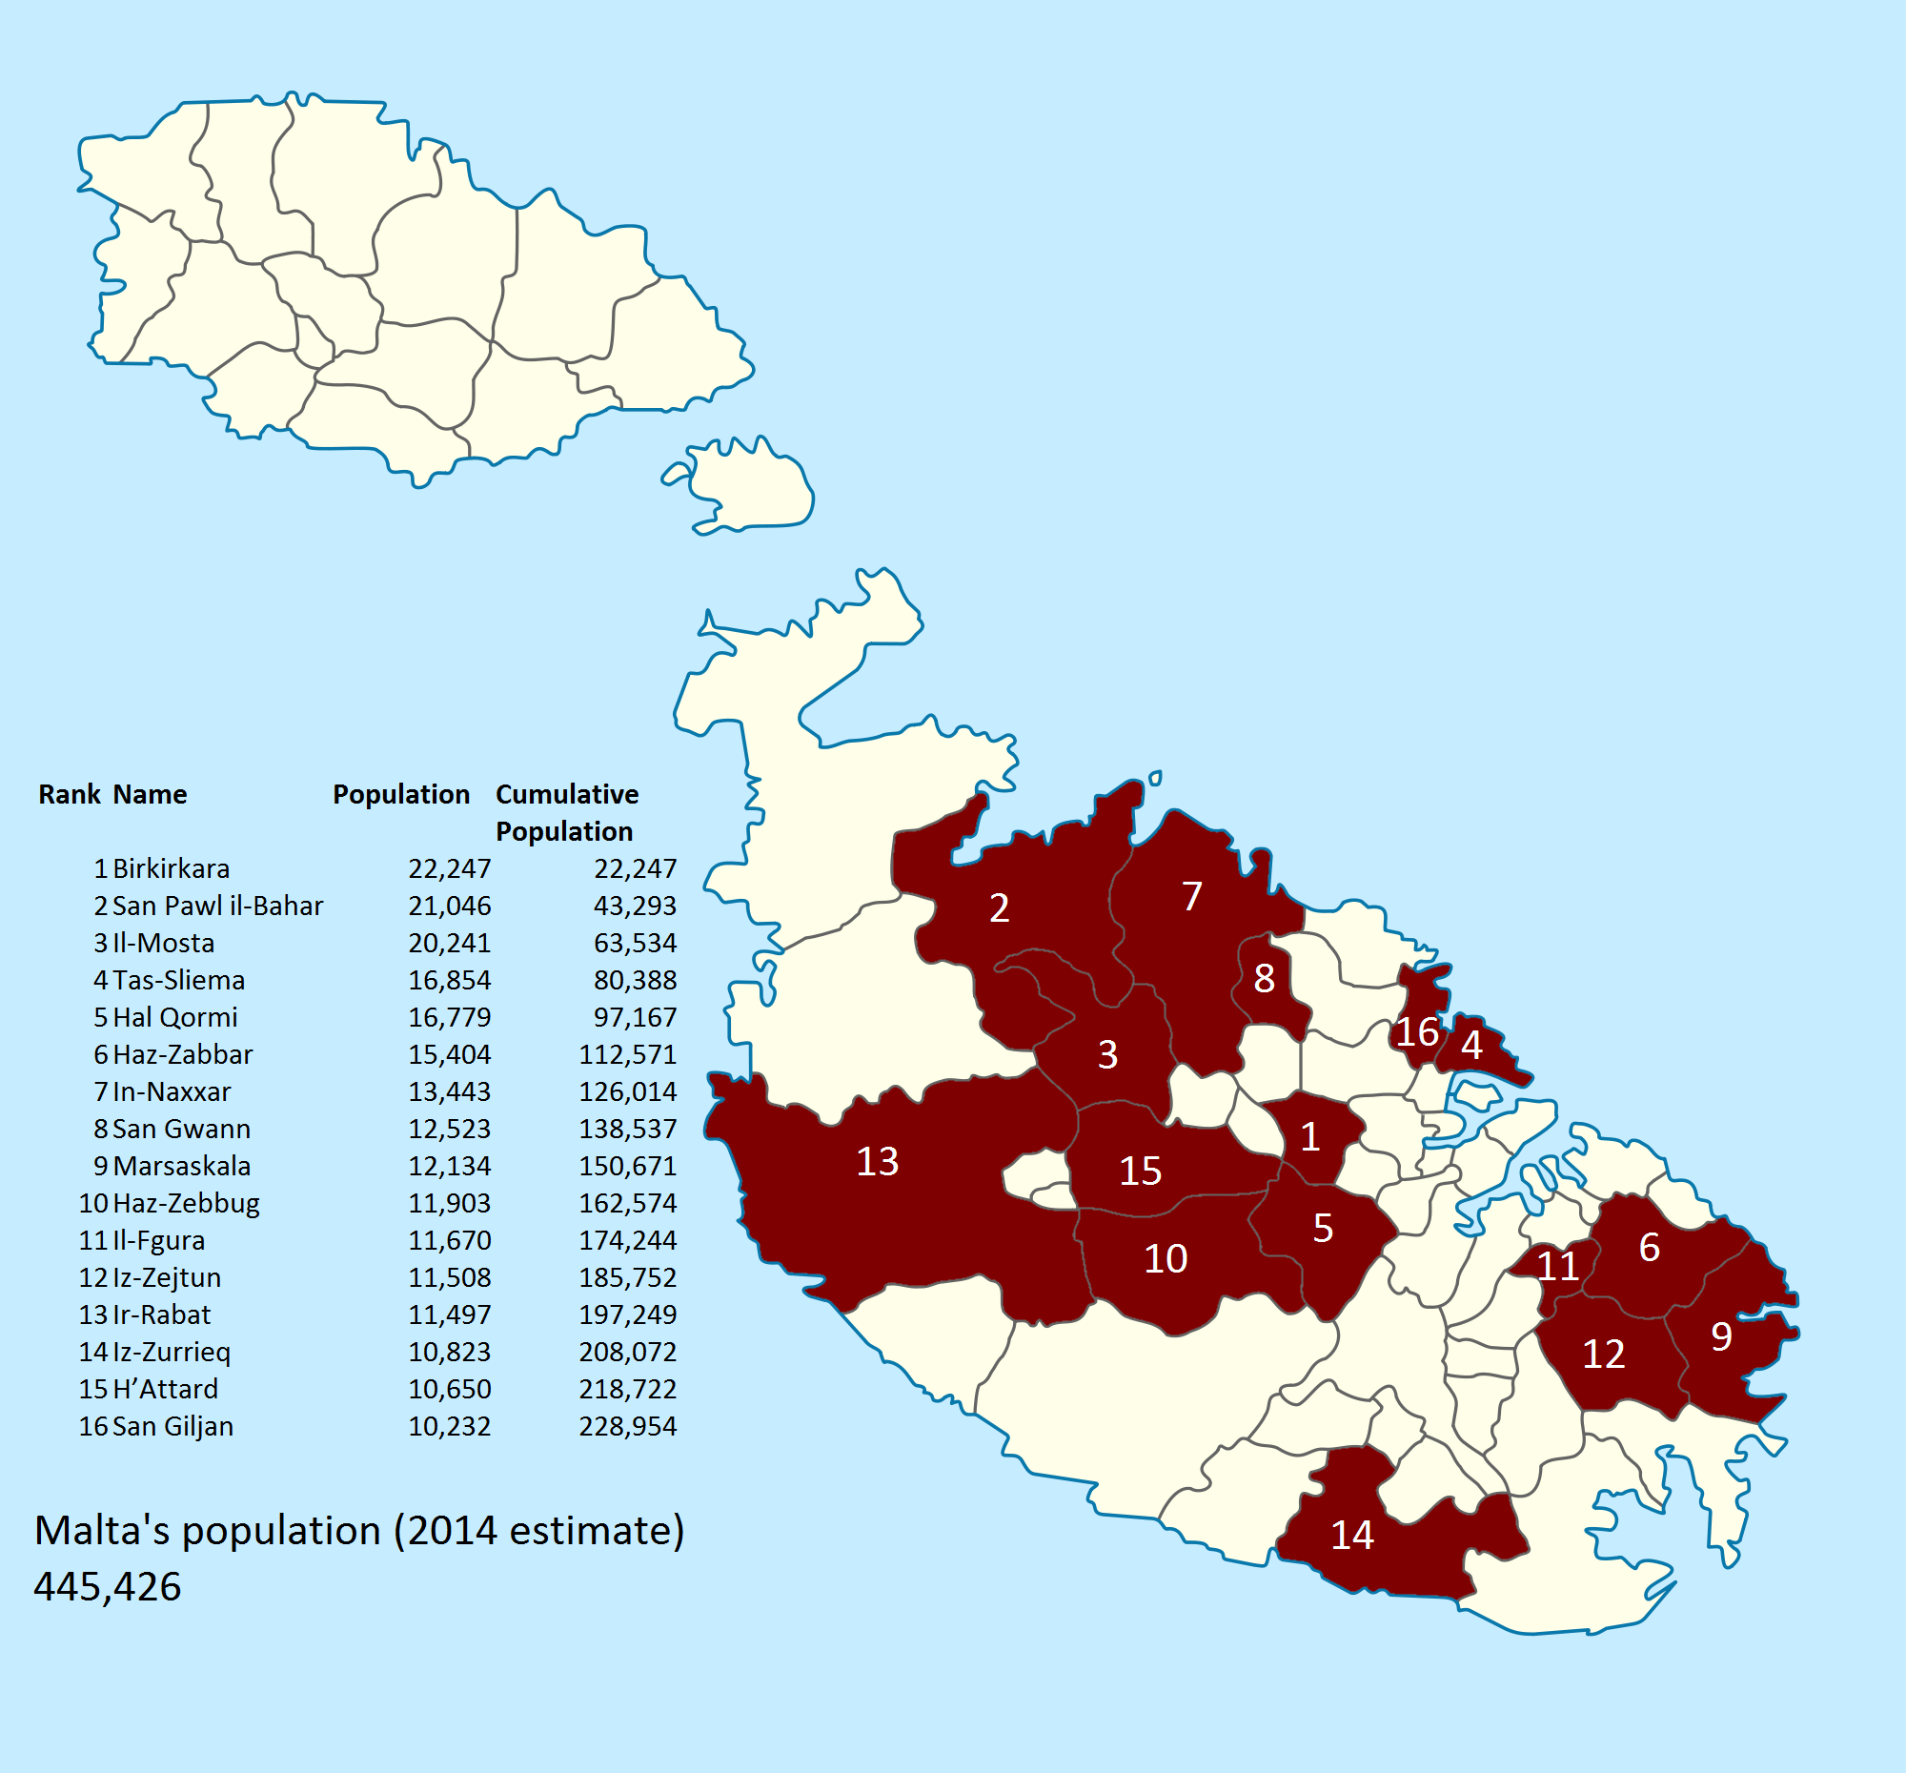
Literature Review
The Urban Area
Built-up areas with high population densities and infrastructures of the built areas.
The threshold population size for an urban settlement varies from 200 to 50,000 people*.
* https://ourworldindata.org/urbanization
https://www.reddit.com/r/MapPorn/comments/40xm0c/half_of_maltas_population_lives_in_the_red_area/
Notes:
The following slides will now cover the literature reviewed
…
Even tho the Definition for Urban area is flexible according to different countries, it can be explained as being a built up area consisting of high population densities and infrastructures.
I felt I should point this out since this term will be mentioned multiple times throughout this research.

Slide 6
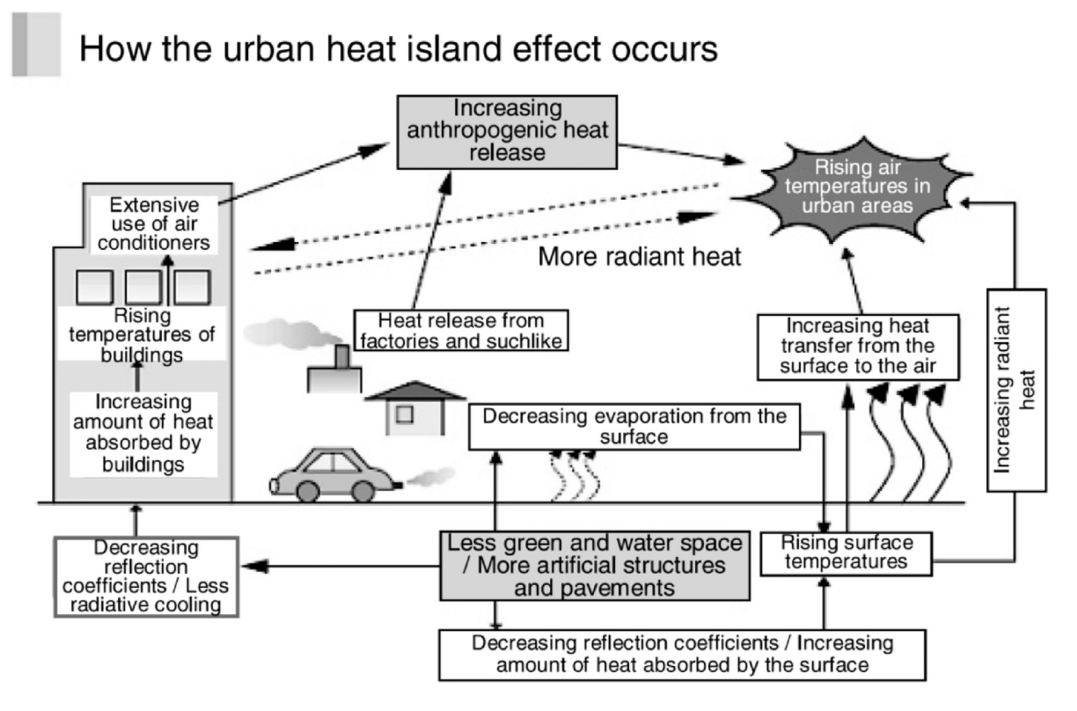
Literature Review
Urban Heat Island (UHI)
UHI is the heat accumulated by the urban climate created by human activities (Arnfield 2003, Nakayama & Fujita 2010)
UHI observed in cities with less than 10,000 citizens (Karl et al. 1988).
Image sourced from Yamamoto (2006)
Notes:
Urban heat island, or UHI, is the area that's a lot warmer than the rural areas surrounding it.
UHI comes from the Heat that is created by energy from all the people, cars, buses, and trains

Slide 7
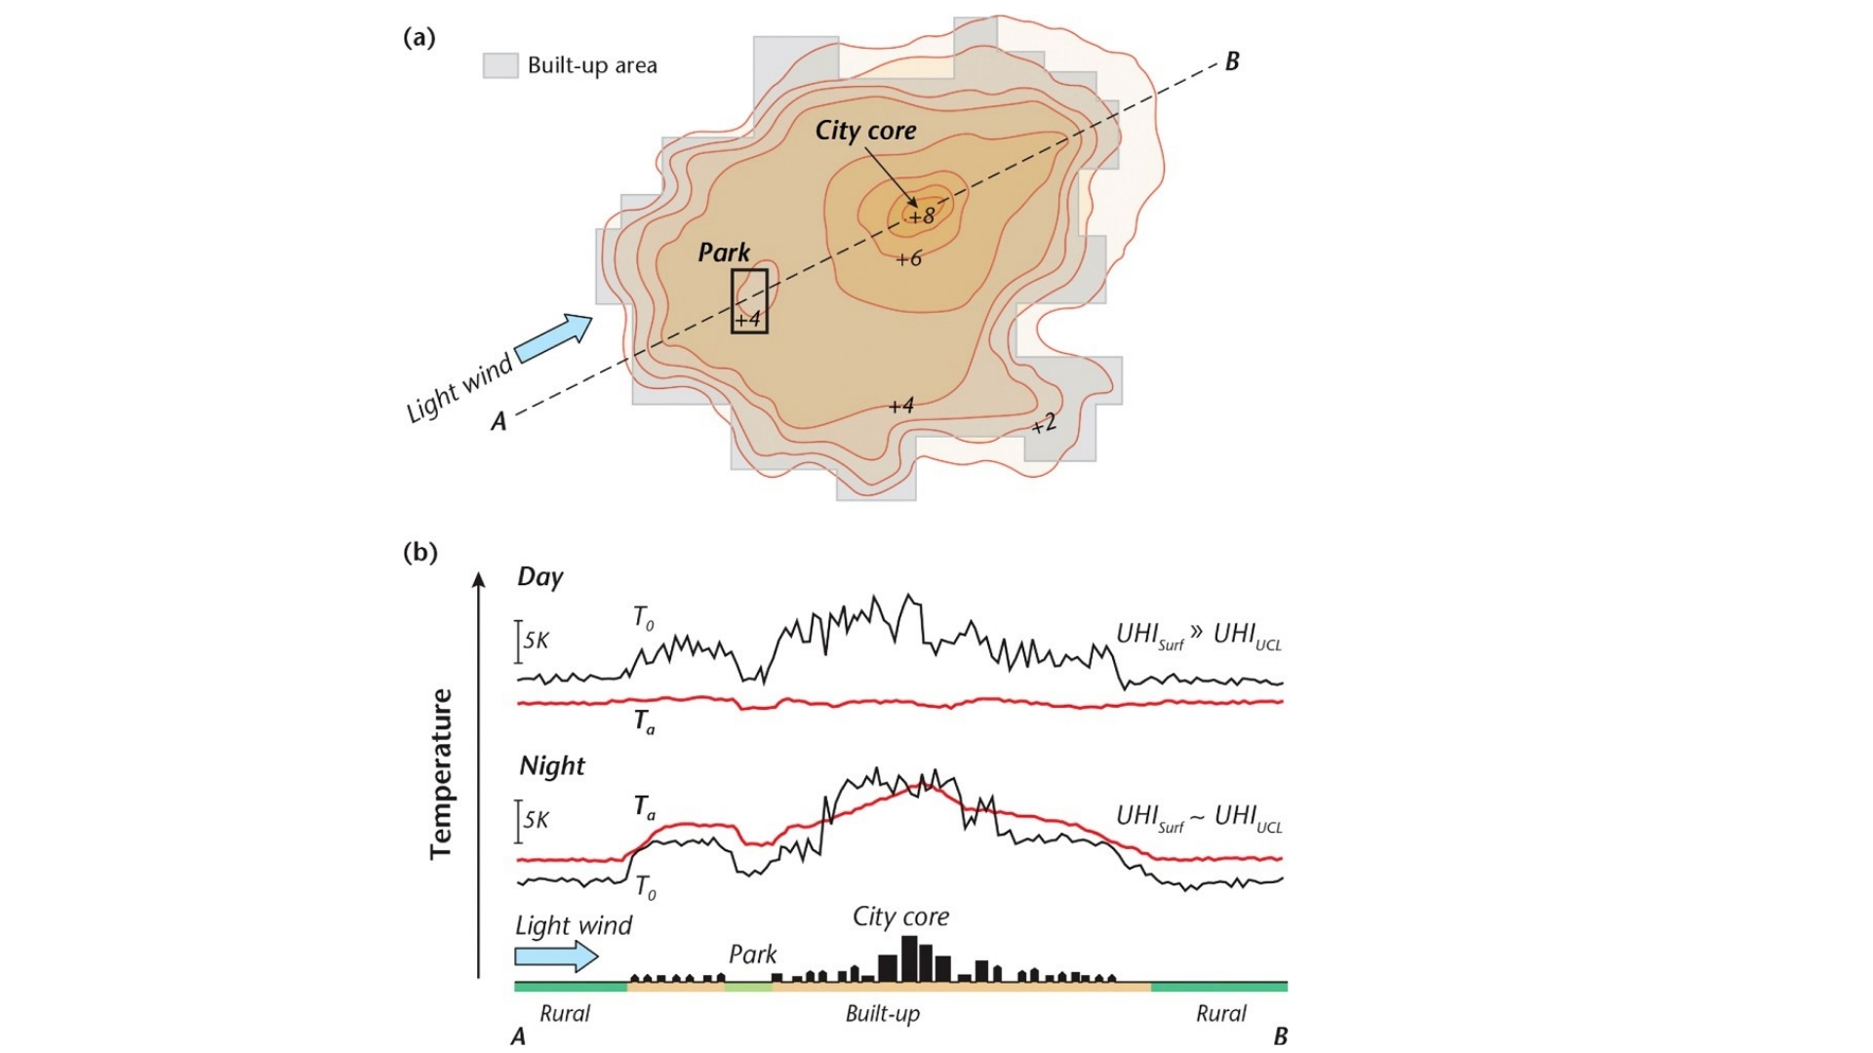
Literature Review
Studies observed a significant difference between air temperature at urban areas vs rural regions (Landsberg 1981).
Results from data during the night showed that rural areas had a mean LST lower than urban areas (Roth et al. 1989).
Image sourced from: https://www.canada.ca/en/services/health/publications/healthy-living/reducing-urban-heat-islands-protect-health-canada.html
Notes:
Additionally, It is cited that the major contributor to the UHI effect is the decrease of heat stored in the soil and vegetation in urban areas
studies observed that during the night, there was a significant difference between air temperature recorded at urban areas with those located in rural regions

Slide 8
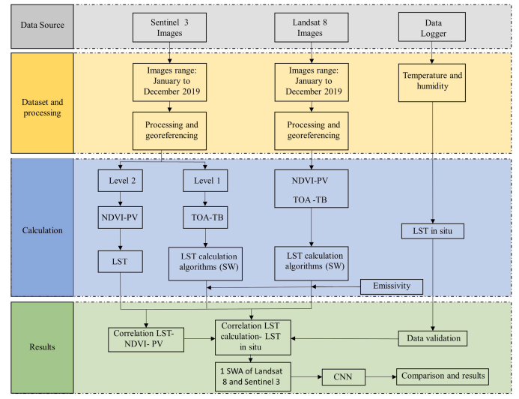
Literature Review
A study conducted by Hidalgo Garcia (2021), used LandSat 8 and Sentinel 3 images to estimate the LST over the city of Granada in Spain.
Data was validated with the temperature values gathered from in situ measurements.
Notes:
This brings us to Remote Sensing accuracy and precision. In a study by Hidalgo Garcia, values from LandSat 8 and Sentinel 3 products were compared to temperature readings gathered from in situ measurements.
The correlation between the datasets was determined, comparing the data source with seasonal and seasonal variations in the same city proving accuracy and reliability of the satellites.

Slide 9
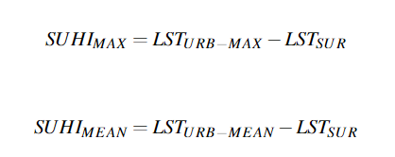
Literature Review
Sobrino & Irakulis (2020) proposed a new methodology on how to calculate and compare Surface Urban Heat Island(SUHI) values.
The method suggests calculating SUHI for the surrounding areas using only LST acquired during night-time.
This method was applied to 71 selected urban agglomerations around the world.
Notes:
However, a lot of literature, changes its methodology according to the individual study areas. Therefore a new standard methodology was proposed and tested on over 71 different cities and urban areas.
This includes the calculation of SUHI which are:
SUHIMAX, can be described as thermal differences between the maximum and mean LST of the urban area,
While SUHIMEAN, is the mean LST of the urban area and the LST of its surrounding area, respectively

Slide 10
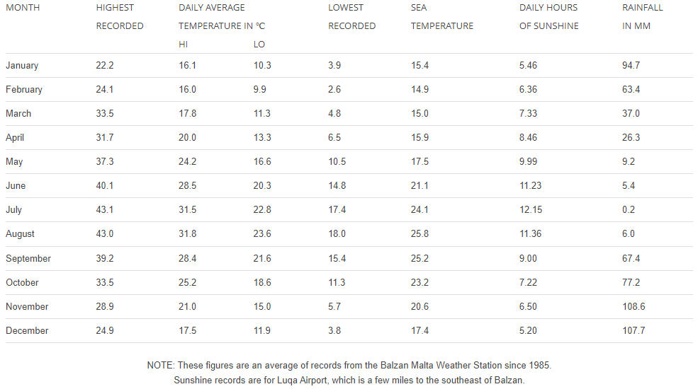
Literature Review
Maltese Climate*
The approximate number of sunshine hours is 3000 hours per annum
Averaging from 5.2 hours in December to 12 hours in July.
Malta has double that of cities in the Northern part of Europe
*https://web.archive.org/web/20150806124550/http://www.maltaweather.com/information/maltas-climate/
Notes:
We get 3000 hrs of sun per year which makes it twice the average of european cities. Hence Malta is much more likely to experience severe UHI than other eu countries

Slide 11
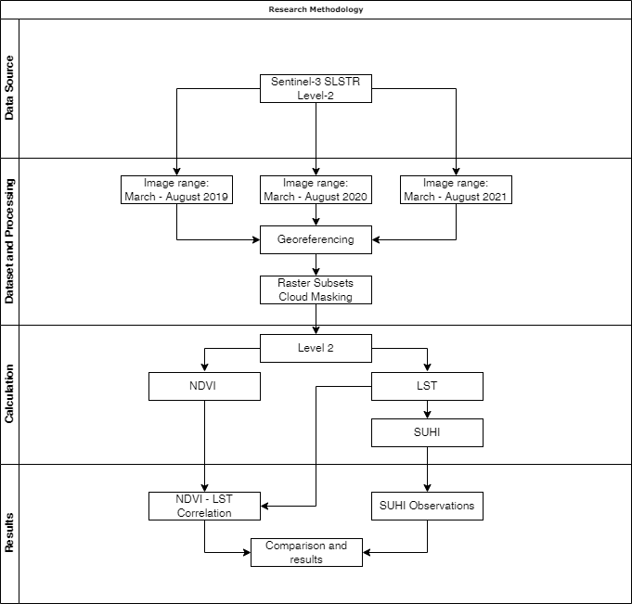
Methodology Research Pipeline
Dataset collection.
Dataset Processing.
Extraction and Manipulation of data.
Data analysis and Results
Notes:
Now moving on to the methodology section, I shall explain the process used throughout this study.

Slide 12
Methodology Dataset Collection
Level-2 LST products were gathered from the Sentinel-3 mission.
Products range from the months of March till August, from 2019 up until 2021.
Night-time remote-sensed products have been used.
A total of 74 SLSTR Level-2 LST products were downloaded for this research.
Notes:
First up, the dataset collection:
By using the ESA’s public database, remote sensing products ranging from March till August from 2019 up till 2021 were downloaded. These products were specifically chosen due to their orbital timing during the early hrs in morning which count as night time products. This was done to better visualise UHI effects.

Slide 13
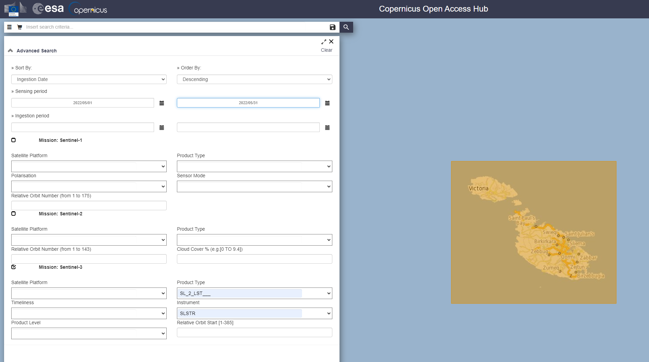
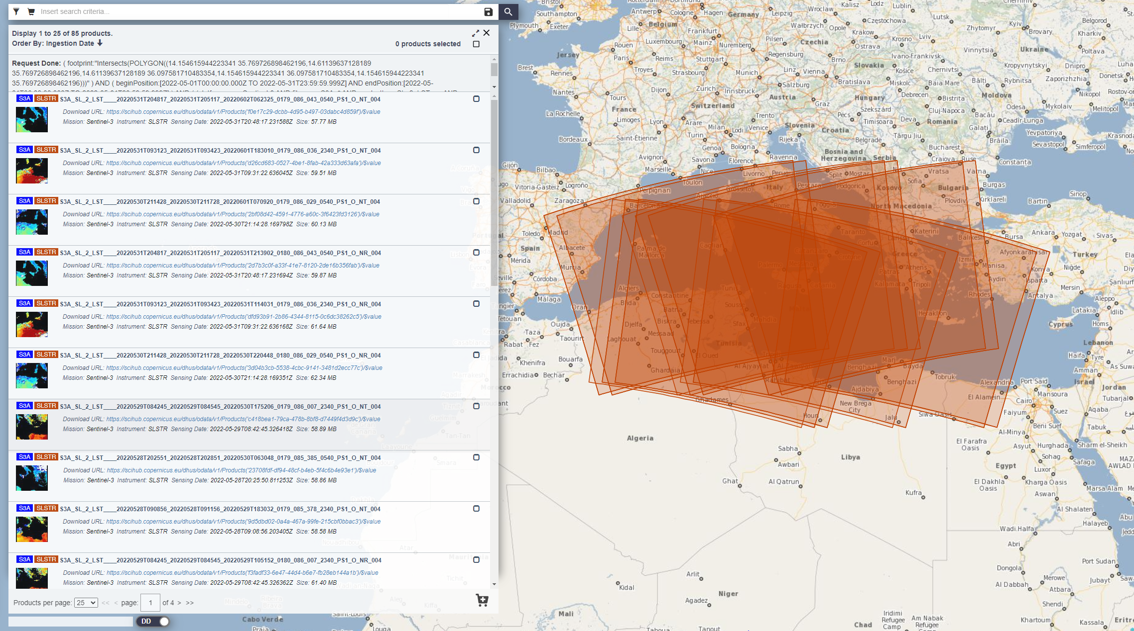
Methodology Dataset Collection
Product list (below)
Setting Range and Area (above)
Notes:
This is how the products were downloaded

Slide 14
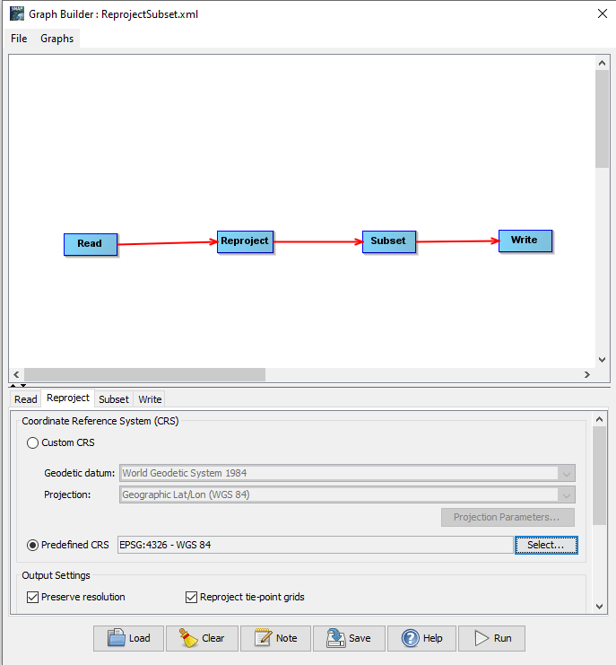
Methodology Dataset Processing
A graph consisting of a Read, Reproject, Subset and Write functions was created.
List and open each product.
Each product had to be re-projected to the Coordinate Reference System (CRS) EPSG:4326.
A subset of each product was created.
Write Reprojected Subset Image as a GeoTiff file (.tif).
Cloud masking each product.
Notes:
Then, by creating a graph consisting of four Functions, the dataset was processed and ready for data extraction.
The first function only consists of listing and opening each product…(go to next slide)

Slide 15
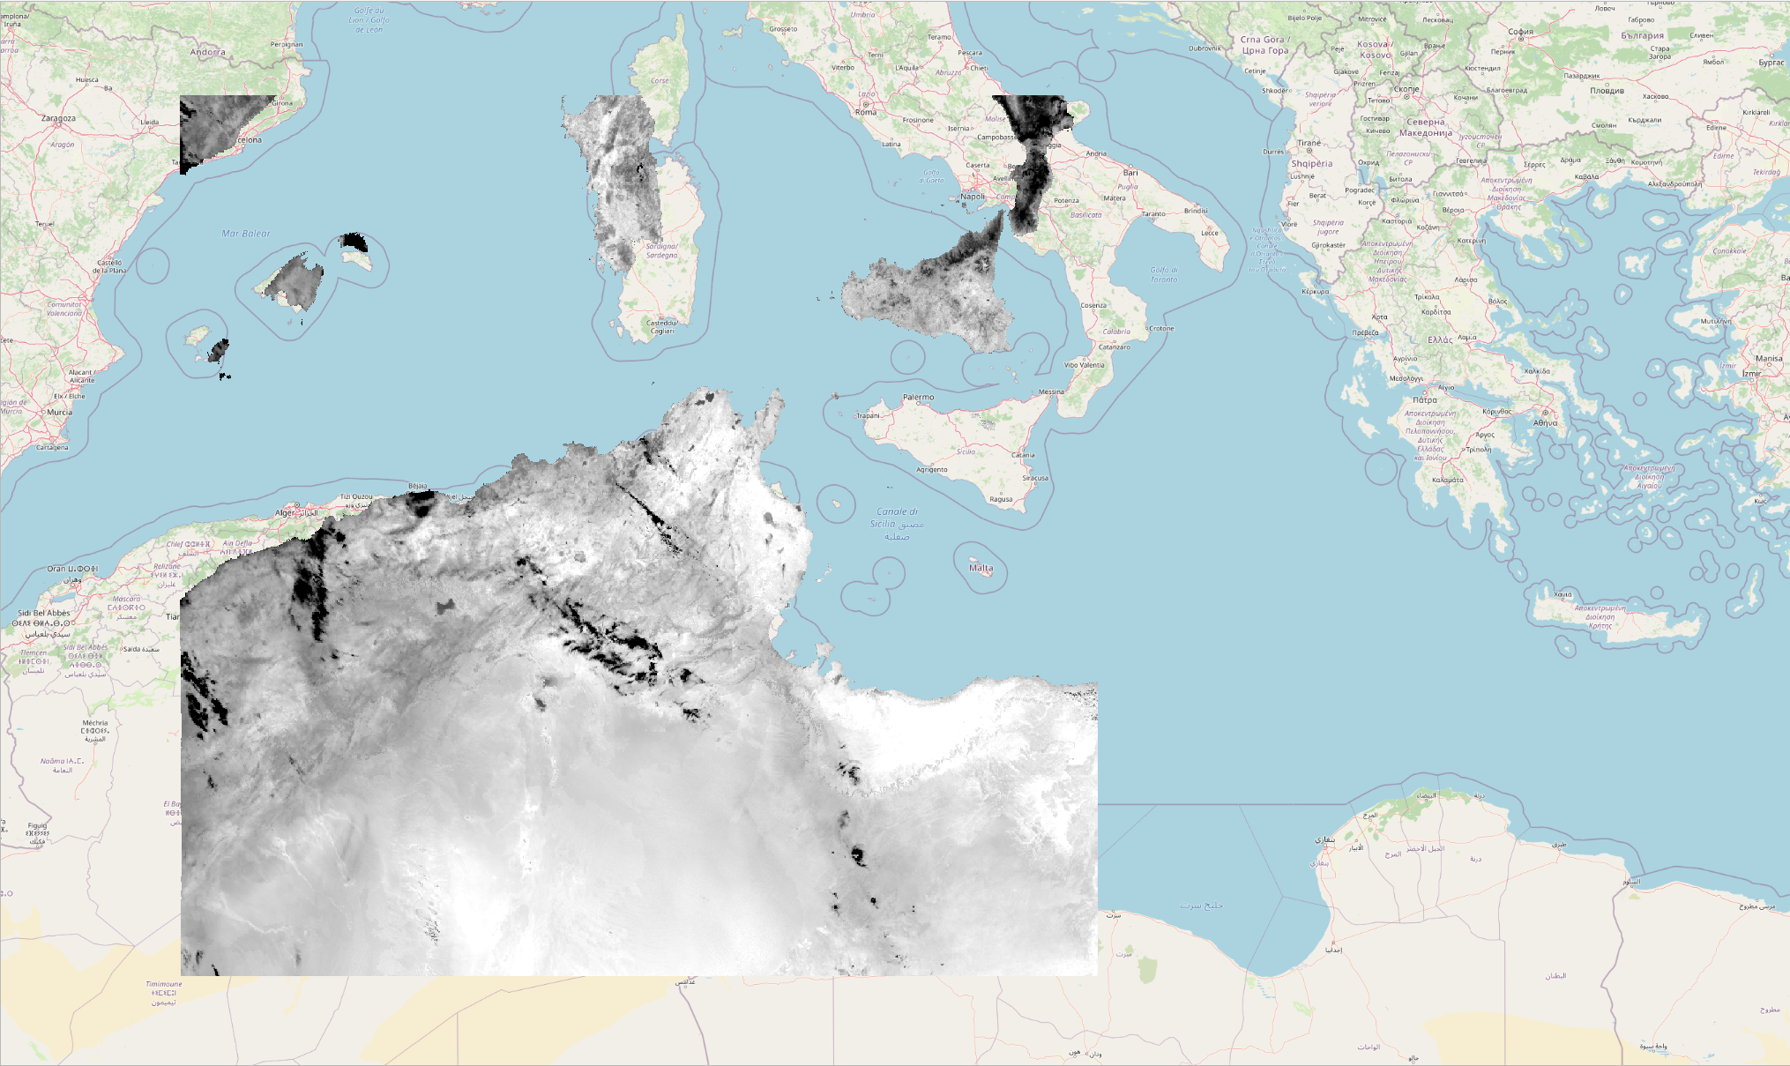
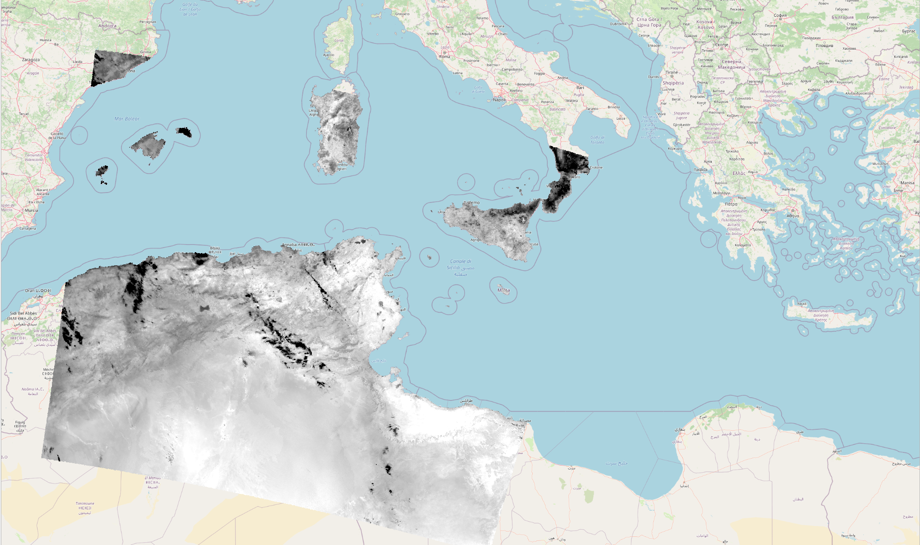
Methodology Dataset Processing
Reprojection
Before
After
Notes:
Each product was reprojected, this consists in changing the coordinates values of a dataset from one coordinate system to another,.. as shown in this slide

Slide 16
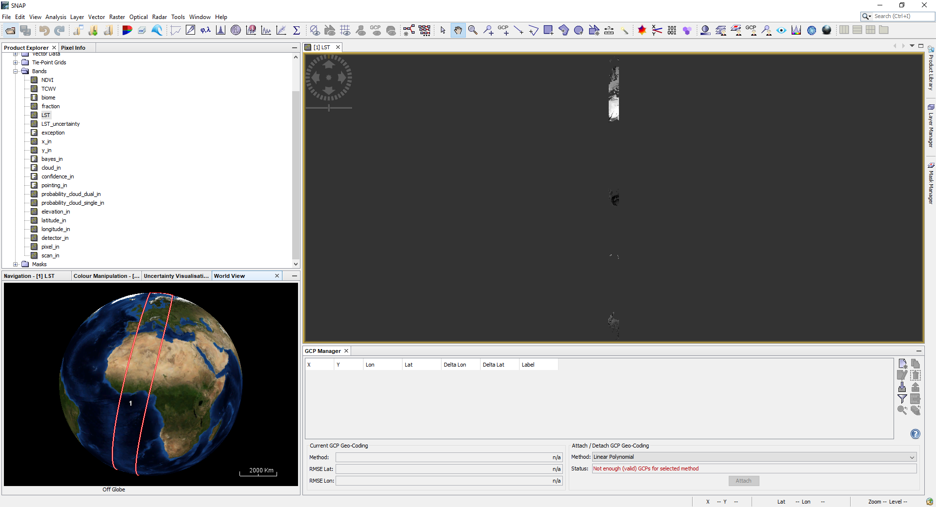
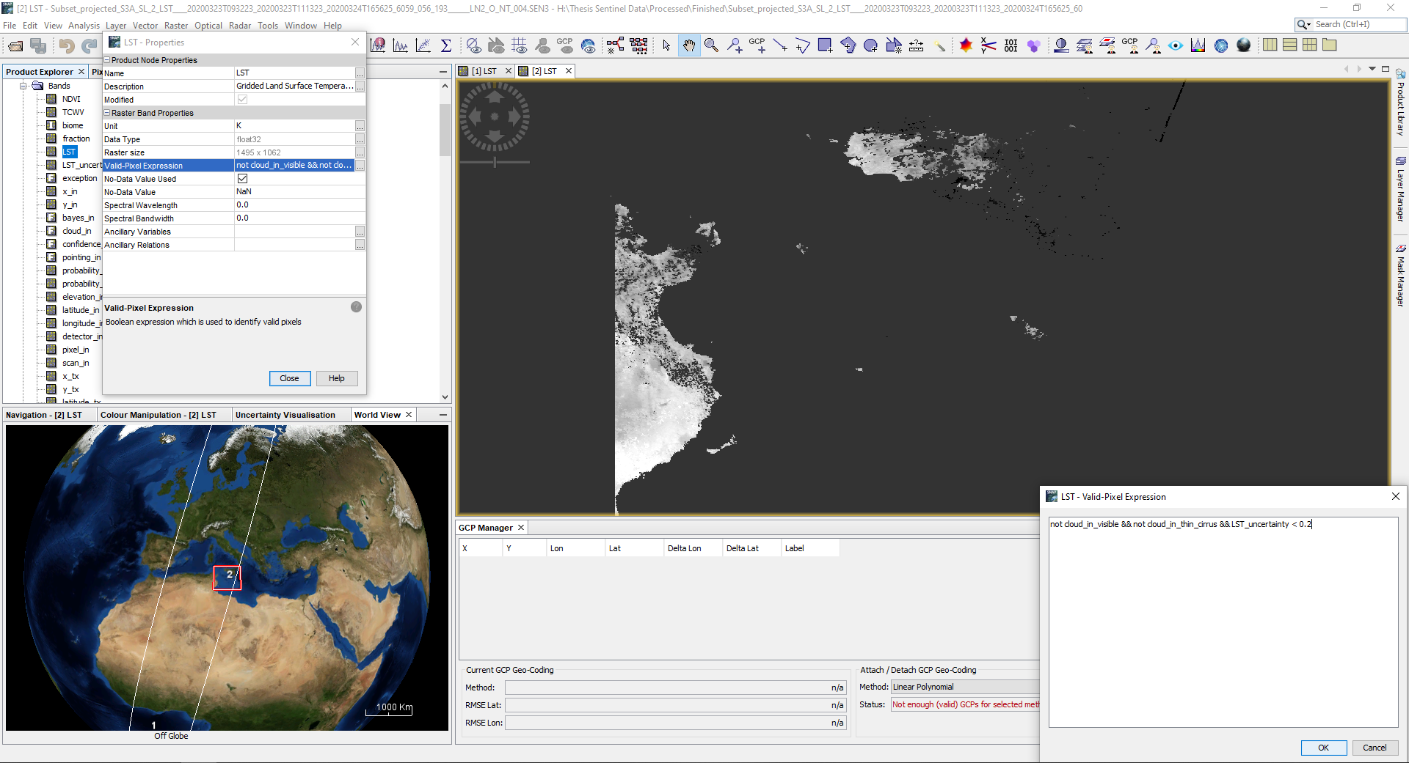
Methodology Dataset Processing
Subset and Cloud Masking
Before
After
Notes:
By creating a subset of each product, data size and processing time were greatly reduced, while cloud masking was done post process.
Cloud masking is the process which detects clouds between clear pixels and cloud shadows pixels, hence avoiding unwanted pixel values.

Slide 17
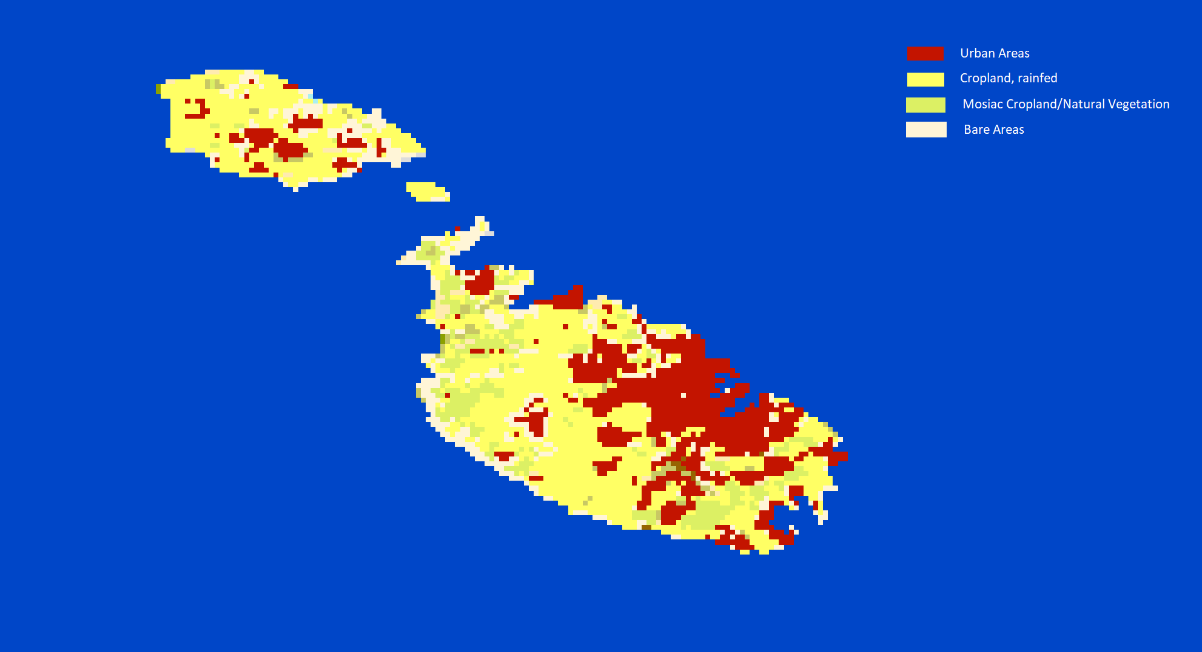
Methodology Extraction and Manipulation of data
ESPON and the EU Commission studies stated that, “the whole territory of Malta constitutes a single urban region”.
Eurostat describes Malta as being composed of 2 urban areas, “Valletta” and “Gozo”.
https://maps.elie.ucl.ac.be/CCI/viewer
https://www.espon.eu/sites/default/files/attachments/fr-1.1.1_revised-full_0.pdf https://ec.europa.eu/regional_policy/sources/docoffic/official/reports/coheter/coheter_en.pdf
Notes:
The biggest difficulty for this research was to define the urban area and its surrounding references.
Thus, the study areas were chosen by using the ESA Climate Change Initiative land cover data, backed by the statements of EPSON, Eurostat and the Eu commission.

Slide 18
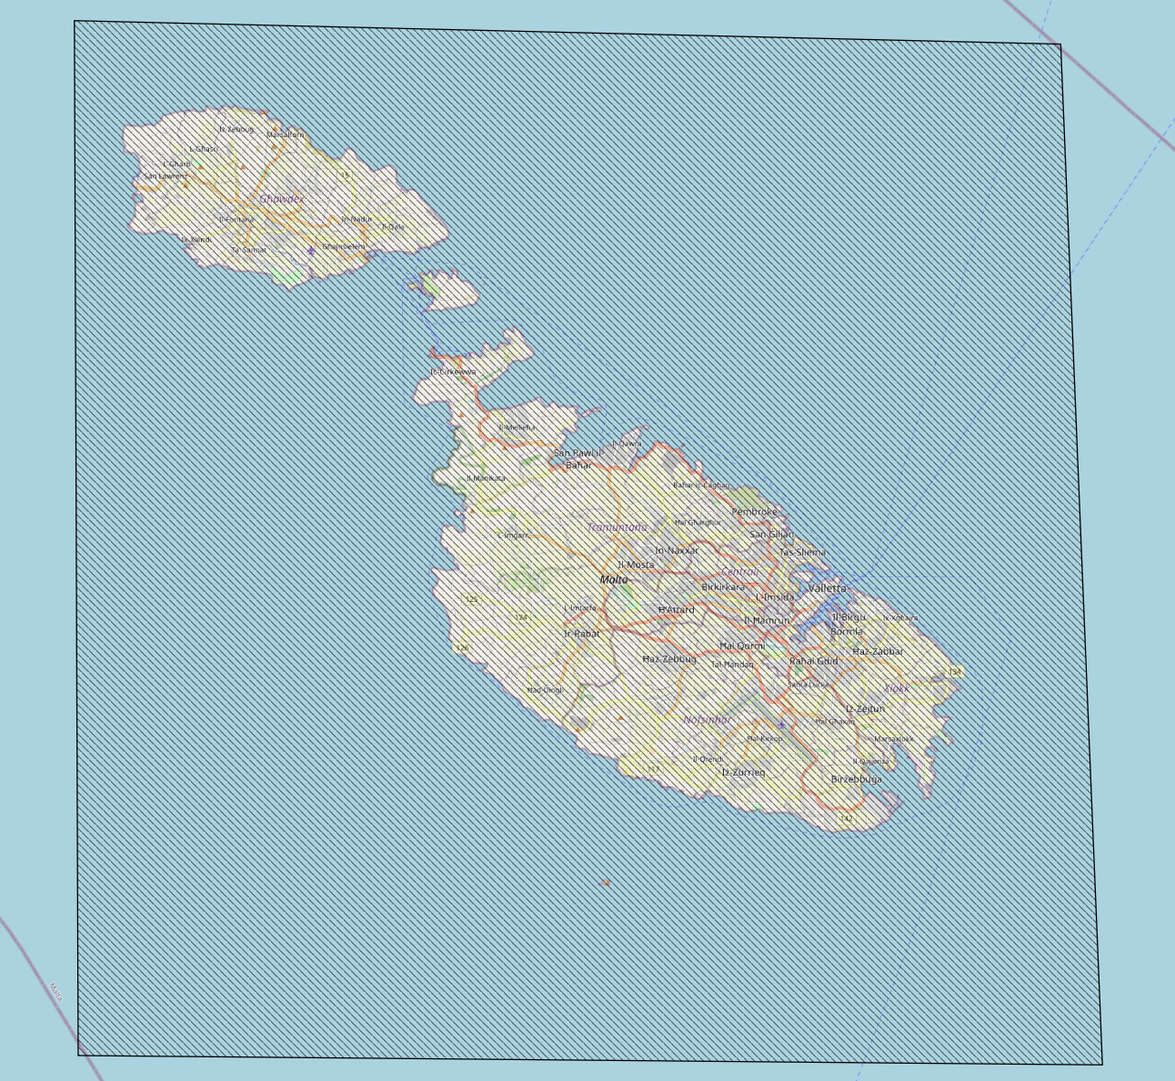
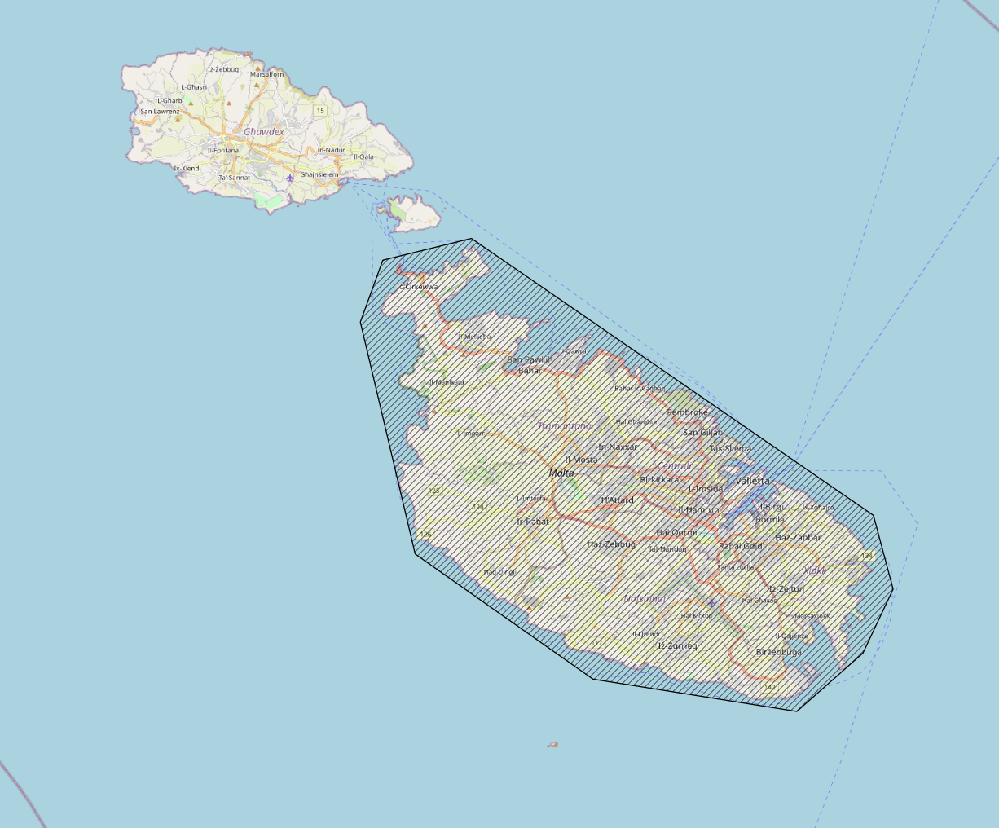
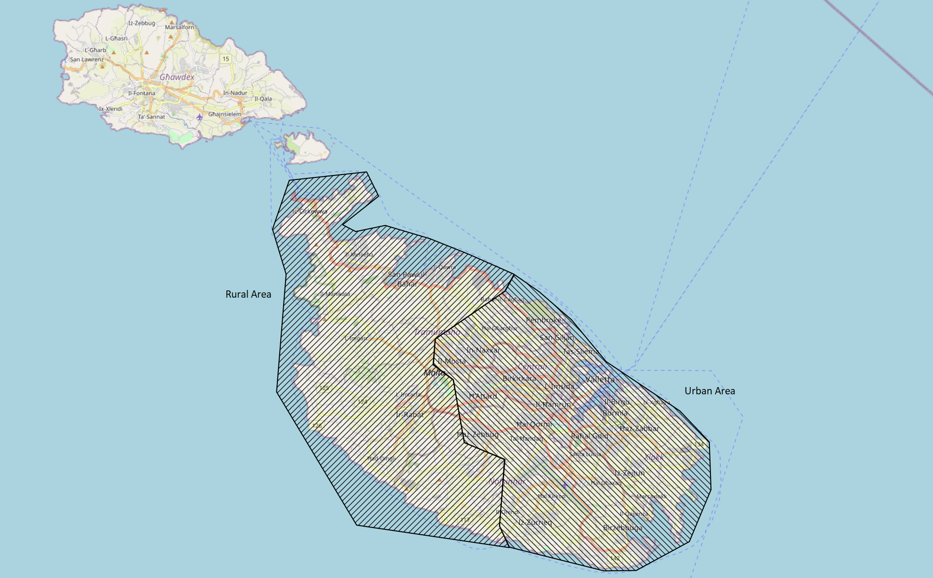
Methodology Extraction and Manipulation of data
A python script was created to traverse all the newly created image (.tif) files.
Each image was split into 4 more subsets:
Maltese Islands
Island of Malta
Malta’s Rural area
Malta’s Urban area
1. 2.
3. 4.
Notes:
By using the information discussed in the previous slide, a python script was developed to process all the newly created images. Each image was then split into 4 subsets as seen in this slide.

Slide 19
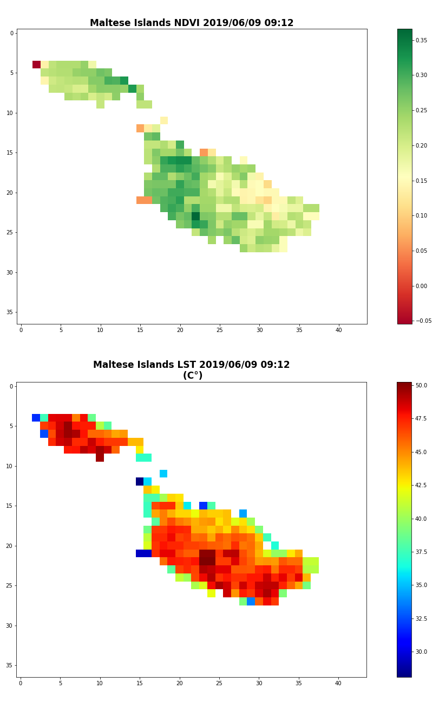
Methodology Extraction and Manipulation of data
Each subset is made up of two Raster bands LST and NDVI.
Each Band was normalised and cleaned from null values.
Mean, Minimum and Maximum pixel values were recorded for each band for each subset.
Notes:
Next, the python script mapped each subset by making use of the two raster bands available in each product
Mean, Minimum and Maximum pixel values were logged for data analysis.

Slide 20
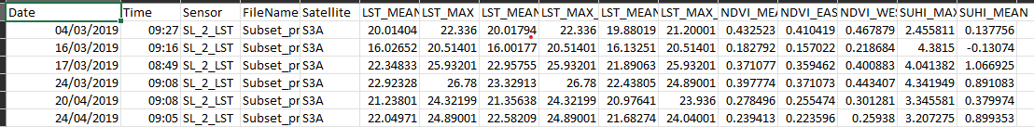
Methodology Extraction and Manipulation of data
Following Sobrino & Irakulis (2020) methodology, SUHI_MAX and SUHI_MEAN were calculated.
Data recorded from the images were saved to a Comma Separated Values(CSV) file.
Notes:
From the logged data, SUHI_mean and SUHI_max were calculated and stored in a csv file alongside other important values.

Slide 21
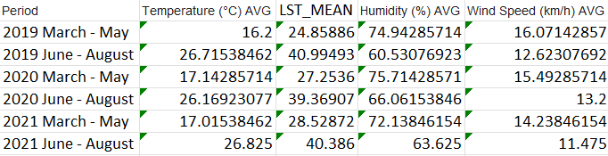
Results
Mean LST values compared to weather data.
Confirming Hidalgo Garcia (2021) conclusion about the accuracy for Sentinel-3.
Notes:
Prior mentioning the results found, I wanted to point out that Hidalgo’s conclusion about the reliability of Sentinel 3 was confirmed by comparing weather station data as pictured in this slide.

Slide 22
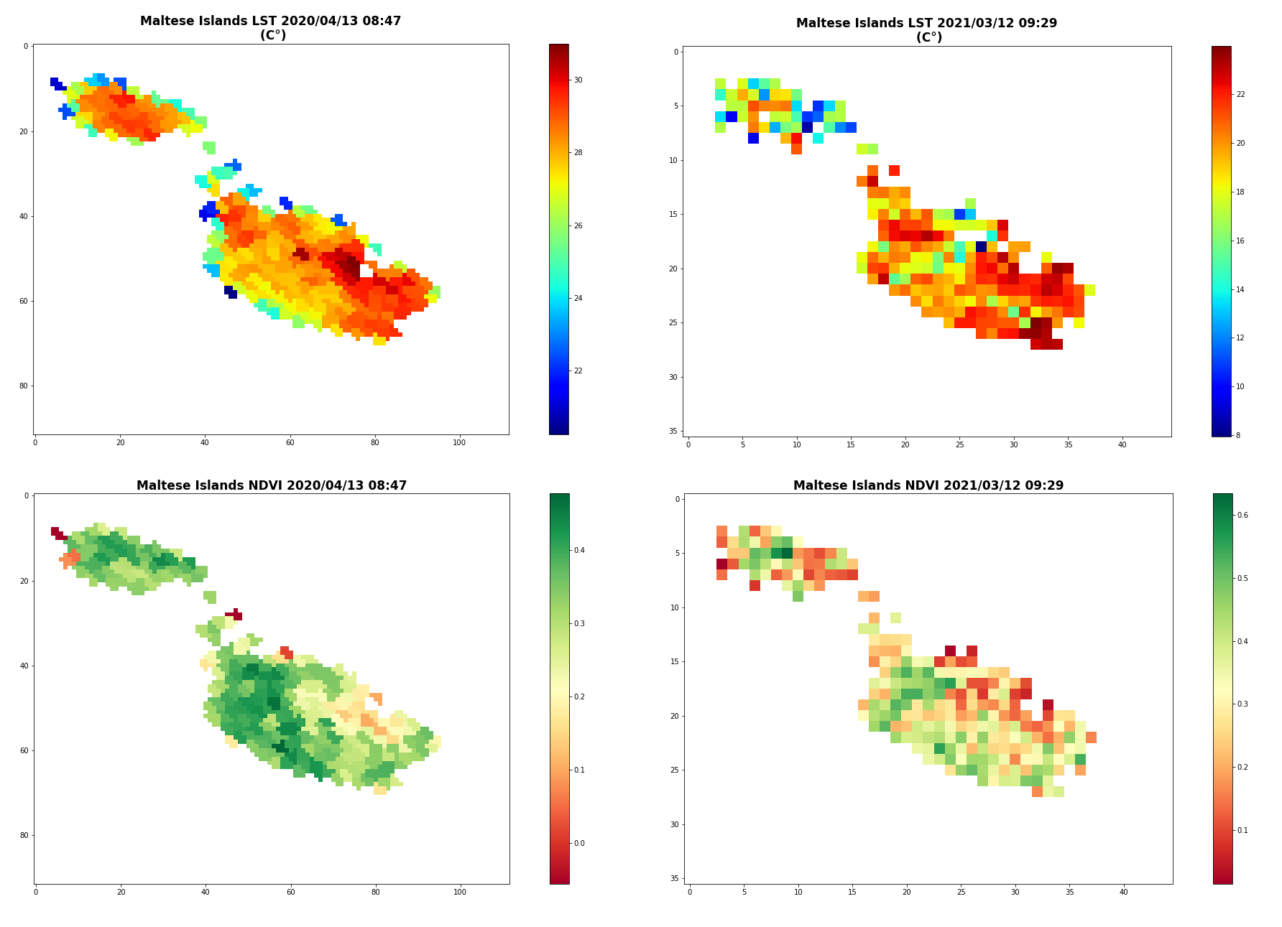
Results
Initial Observations
LST values make UHI observable.
Peak LST values happen in Summer.
Green spaces and Vegetative areas emit the least LST values
Developed or barren areas emit the highest LST values.
Notes:
The first part of the results is about observing the mapped values.
Just from observation, we can already deduce that:
Peak LST happens during summer, green spaces emit the least LST values, while developed or barren areas emit the highest LST.

Slide 23
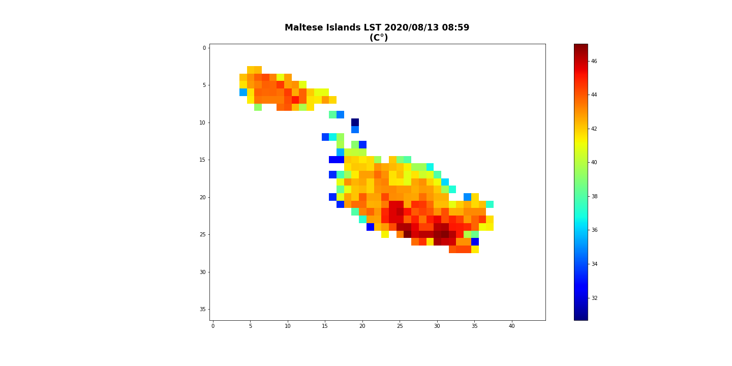
Results
Geographical position and the effect of the sea breeze on temperatures is mitigated by the presence of vast bodies of water.
This phenomena overlaps with UHI in coastal cities, causing local climate change.
Abnormal temperatures in areas which literature about inland cities says should not exist.
Notes:
Another observation worth mentioning is the effect that sea breezes have on the LST.
As pictured in this slide, one can notice that this phenomena can cause a local climate change. This means that abnormal temperatures can be found in places where literature says should not exist.

Slide 24
Results
Analysis for “Covid” Period
Upward trend in LST values and a downward trend for NDVI.
Slight decrease in uptrend was noticed throughout the year 2020.
Mean LST +15%
Increase in temperature equal for both the Rural and Urban areas.
Mean NDVI -12.4%
Decrease in NDVI values in the Rural areas higher than the Urban Area
-13% in the Rural VS -10% in the Urban area,
Notes:
The second part of the results consist of data analysis.
When analysing the covid period, which are the months between march and May, a Slight decrease in uptrend was noticed throughout the year 2020 - This means that daily human activities, although not impactful enough to reverse the uptrend immediately, are also part of a bigger picture when studying UHI. (go to next slide)

Slide 25
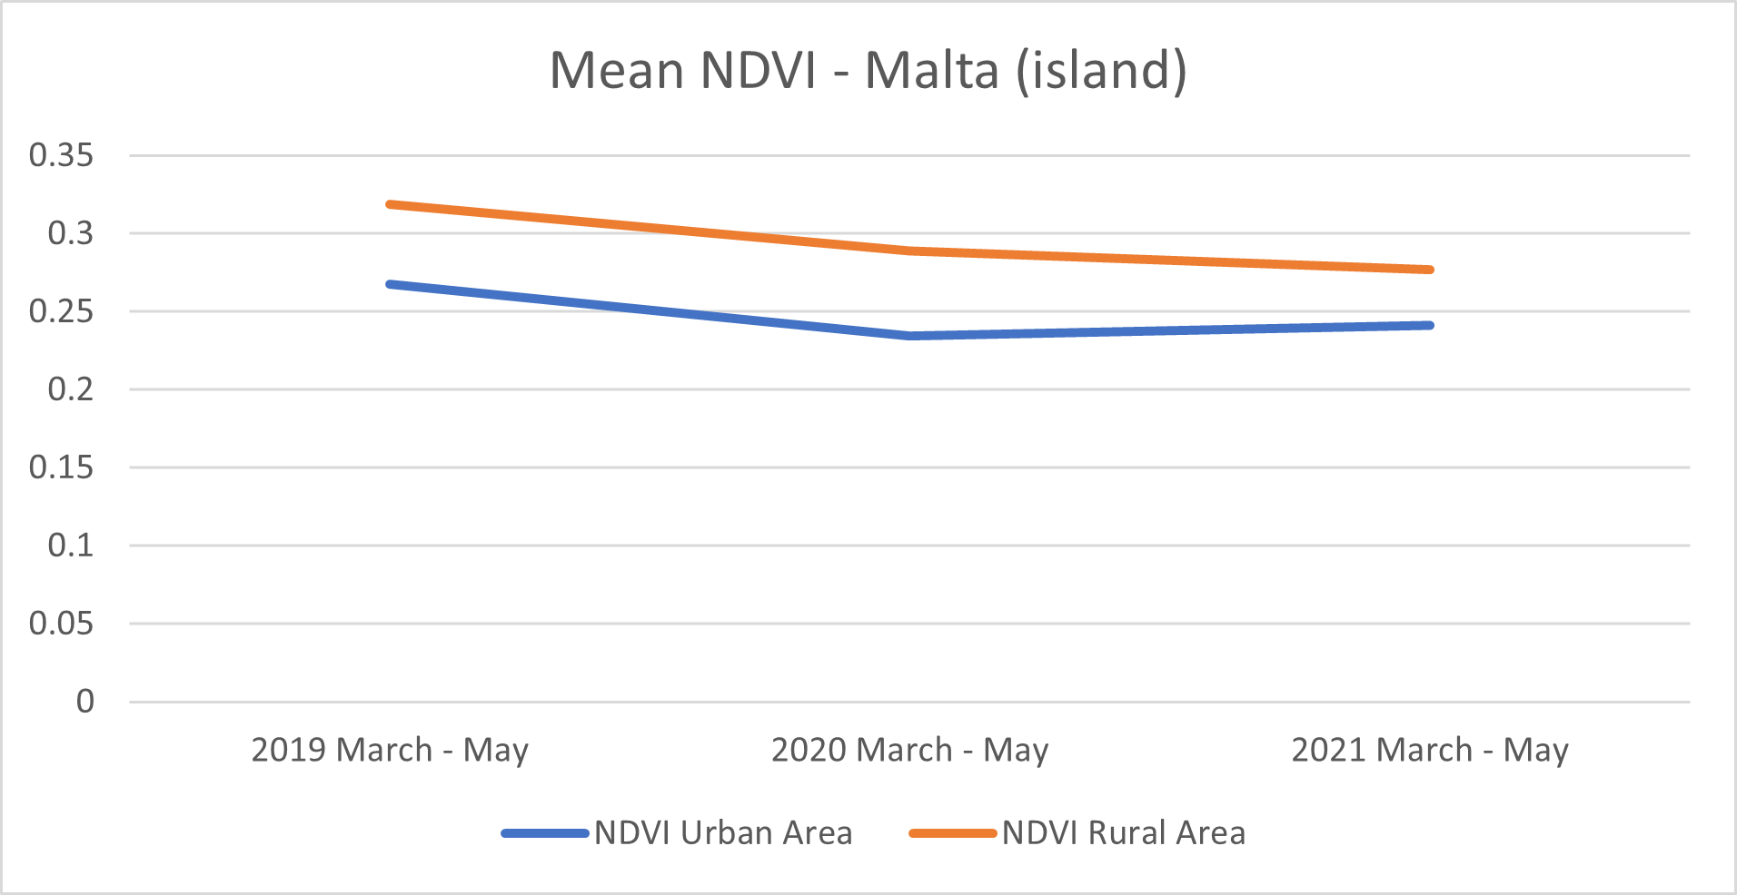
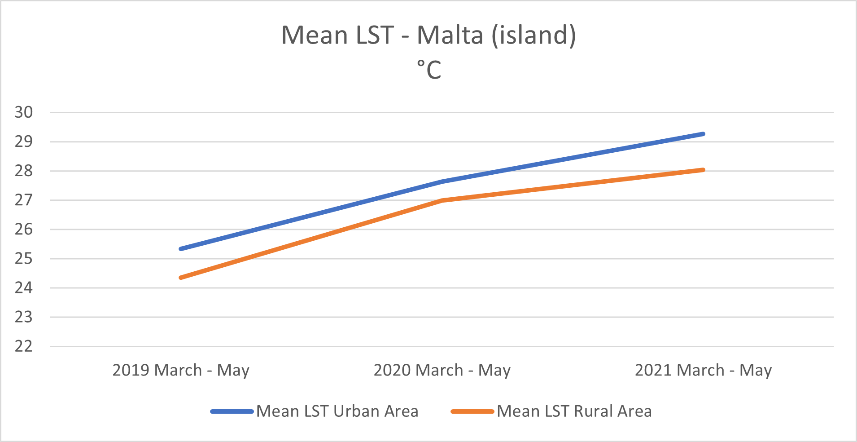
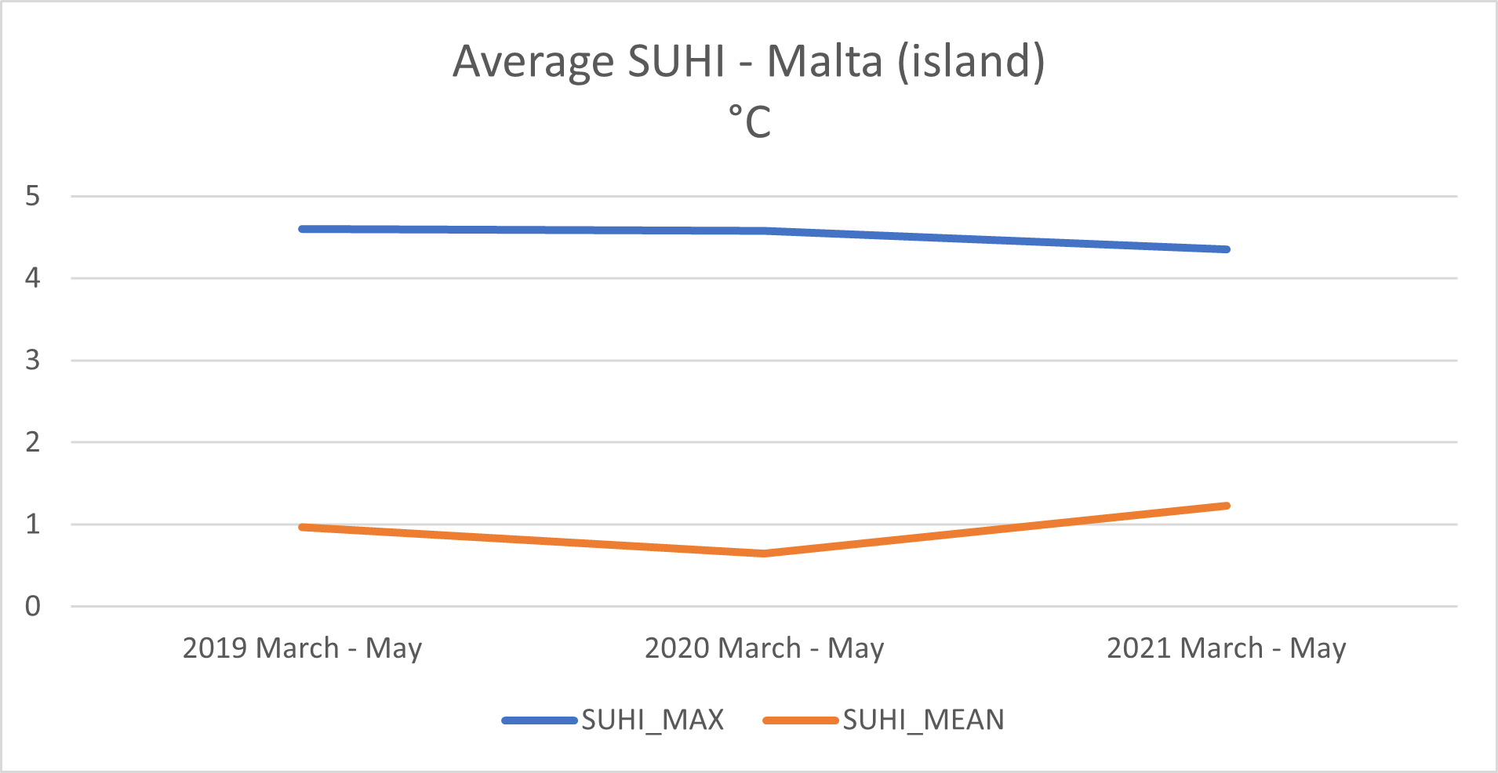
Results
“Covid” Period
Notes:
As you can see, the Increase in temperature is equal for both the Rural and Urban areas - This means that the Rural area was not able to dissipate heat any quicker than the Urban area.

Slide 26
Results
Analysis for “Summer” Period
Downward trend in LST values and a downward trend for NDVI.
Drop in Mean LST was noticed from the year 2019 to 2020.
Mean LST -1.5%.
Mean NDVI -11%
Decrease in NDVI values in the Rural areas higher than the Urban Area
-18.5% in the Rural VS -14.7% in the Urban area,
Notes:
Moving on to the summer period, a downward trend for LST and NDVI was observed. This downtrend in NDVI could be explained by the increasing development, the island is experiencing (go to next slide)

Slide 27
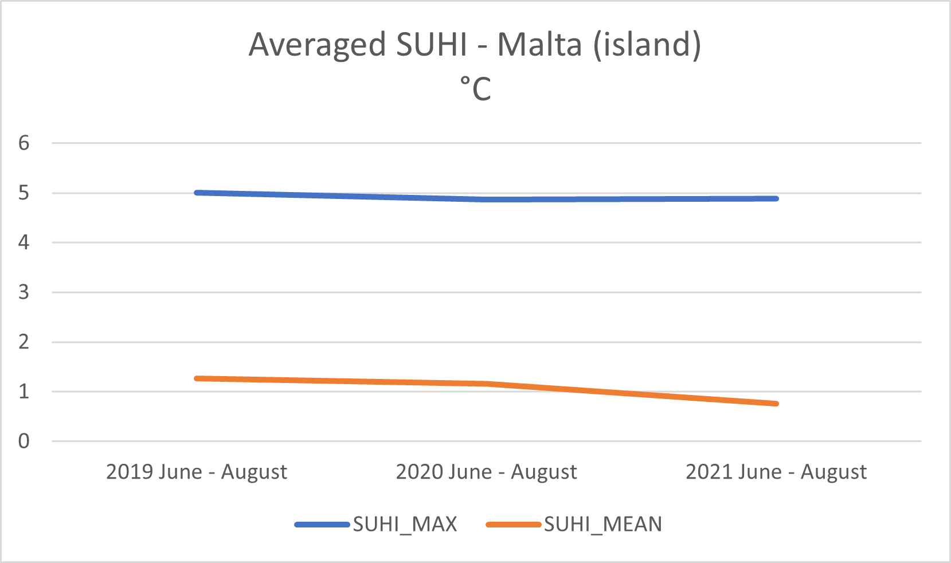
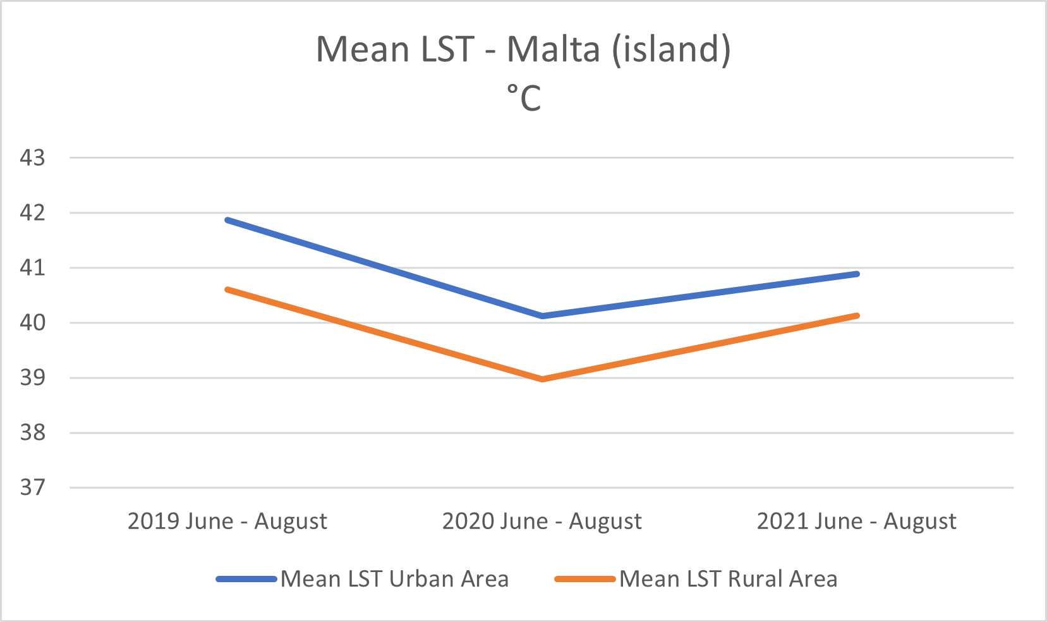
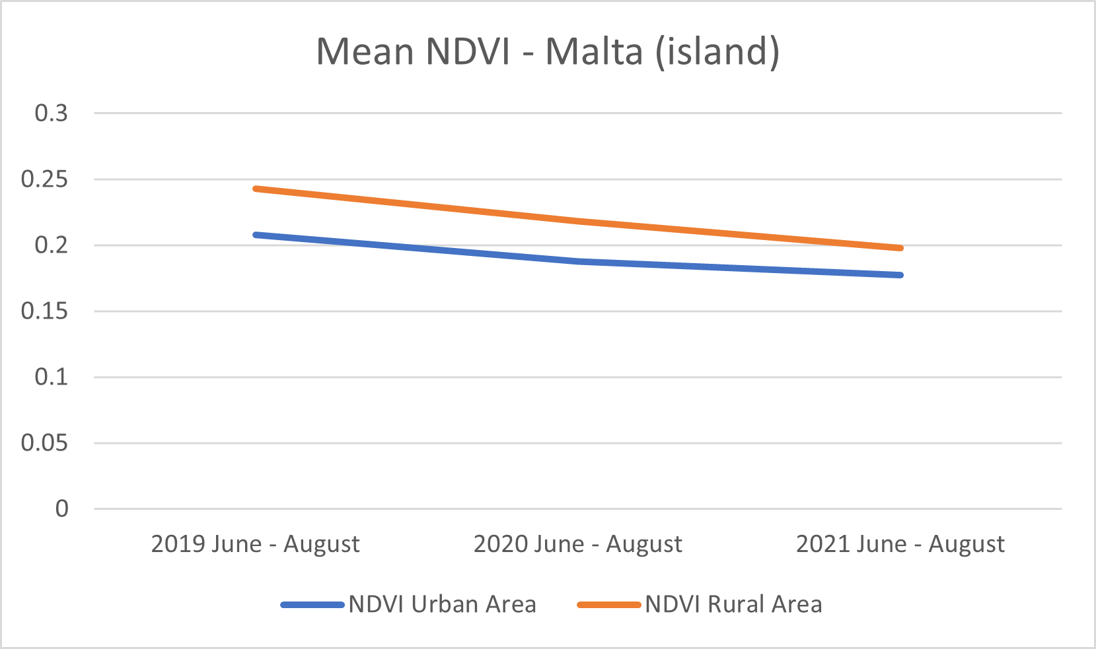
Results
“Summer” Period
Notes:
An interesting point about this period is the drop in mean LST from the year 2019 to 2020, which could explain the overall decline in LST

Slide 28
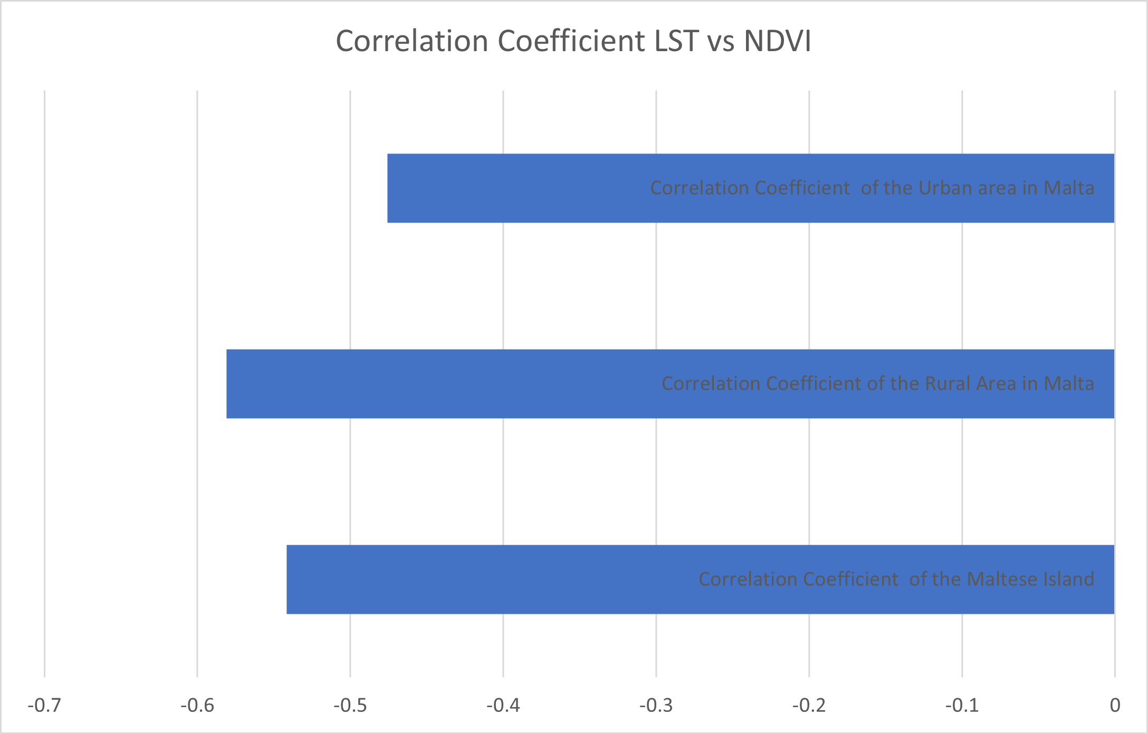
Results
Correlation Analysis
Correlation Coefficient of the main island of Malta is at -0.54
Correlation coefficient of the Rural Area was -0.58
Correlation coefficient of the Urban Area was -0.48,
Notes:
The third part of the results was about finding the correlation between LST and NDVI. As you can observe, a negative correlation coefficient was found.
The disparity between the urban and rural areas may be explained by other factors, such as nearby water bodies or humidity in rural areas.

Slide 29
Conclusions
Is Remote Sensing a viable option to track and observe the UHI effect in Malta?
Does the UHI effect exist in Malta?
Can UHI be tracked and analysed accurately over a period of years using Remote Sensing technologies?
Remote Sensing is a great option to track and observe the UHI effect in Malta.
UHI does affect Malta
UHI observed and analysed from 2019 – 2021.
Notes:
In essence, this research concludes that remote sensing is a great option to track and observe the UHI effect in Malta,..
Secondly UHI does affect Malta and is trackable across a period of time(next slide)

Slide 30
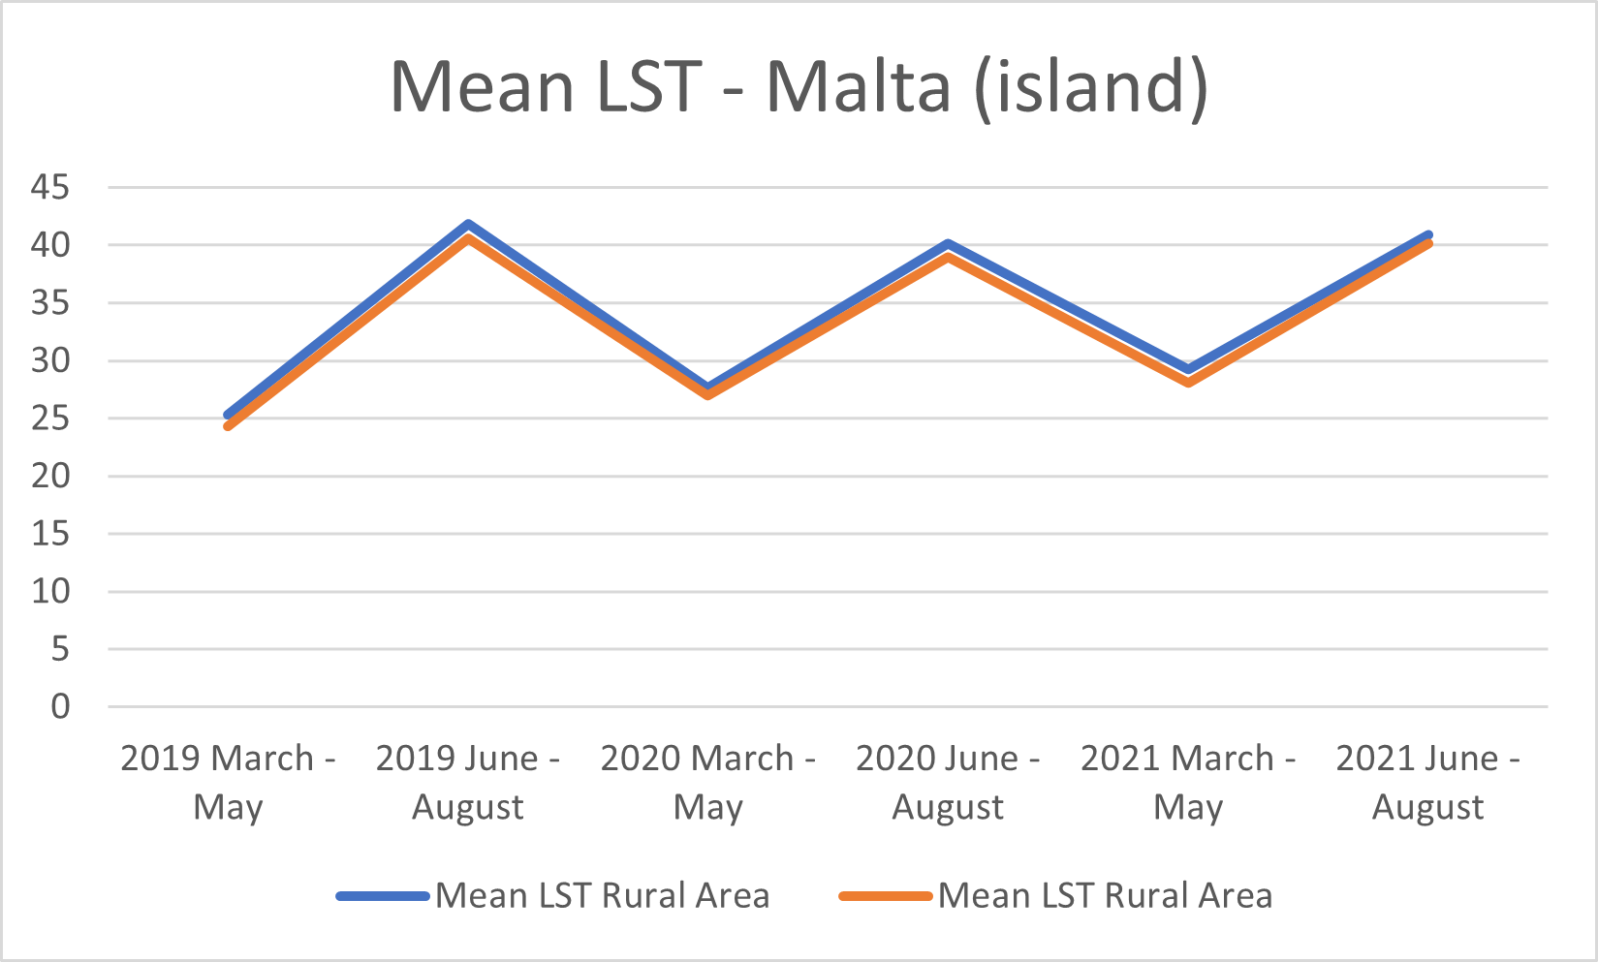
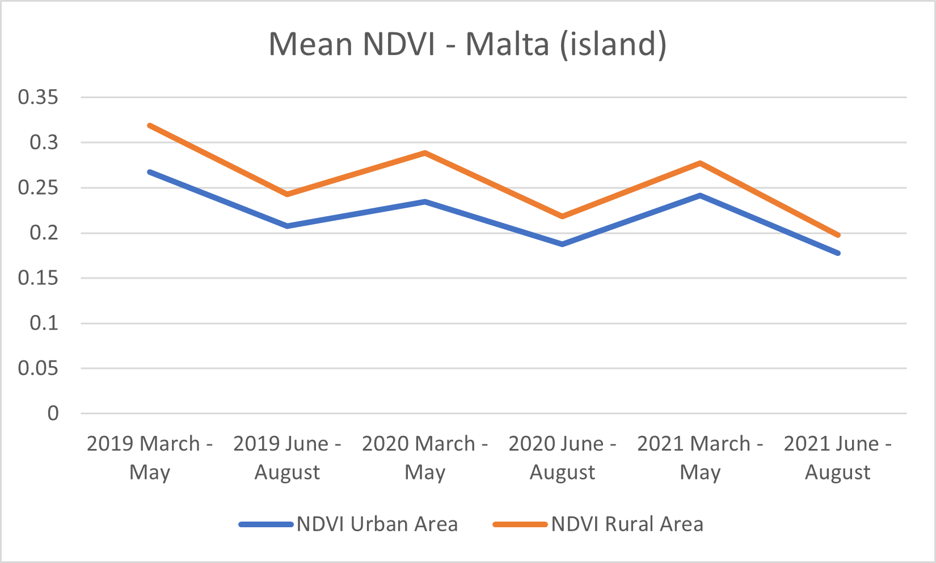
Conclusions
What kind of observations can this data provide?
Peak LST Values recorded in August.
Upward trend in Mean LST.
Downward trend in Mean NDVI.
LST vs NDVI correlation.
Uptrend slowed slightly throughout the year 2020.
Notes:
Some significant observations this data provided were: the visible trends in LST and NDVI, the slightly slowed uptrend during 2020, LST and NDVI were confirmed of having a correlation..(next slide)

Slide 31
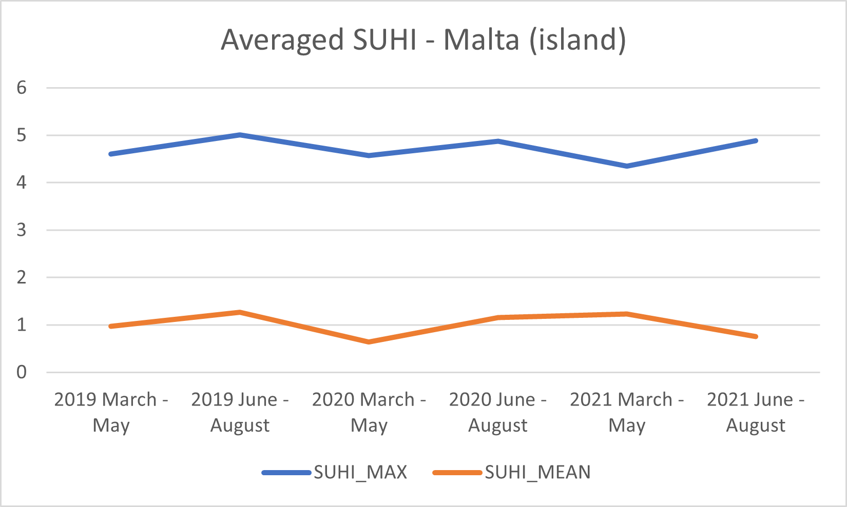
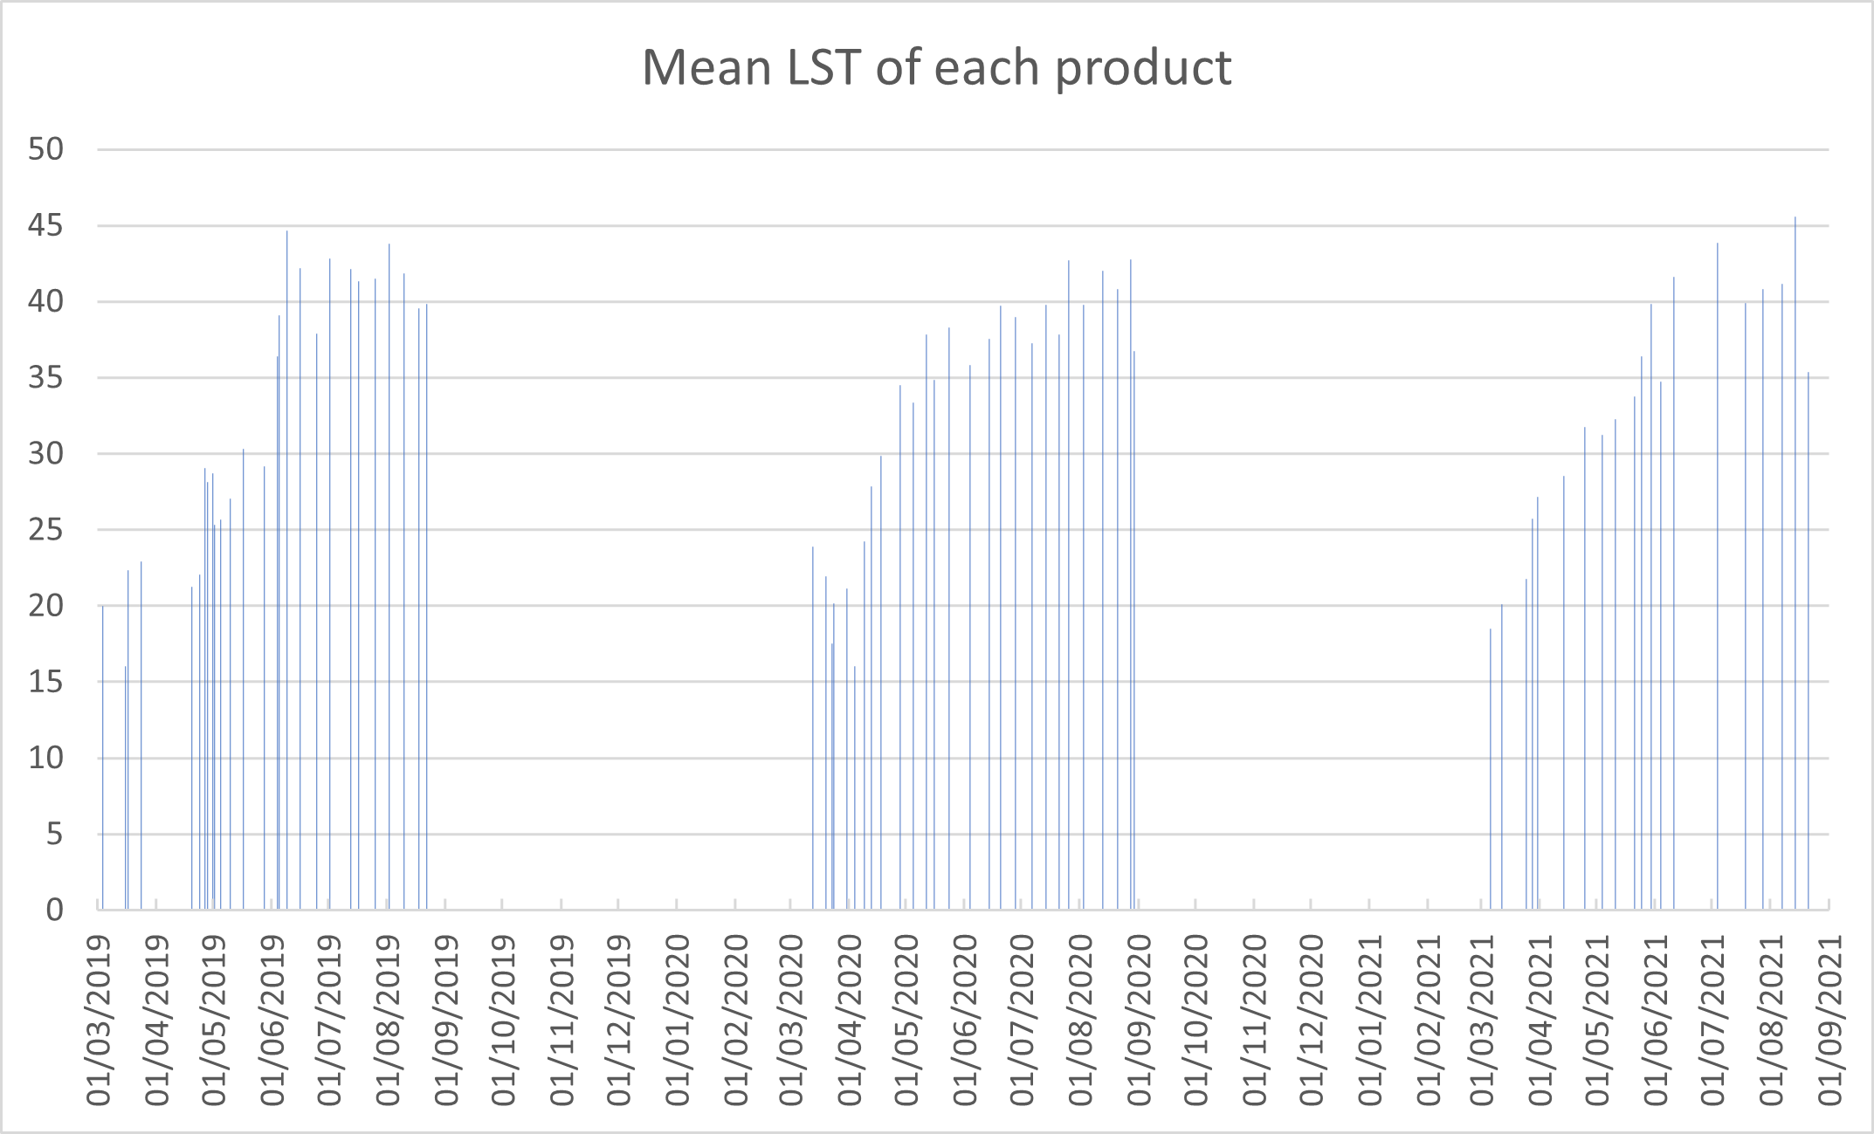
Conclusions
What kind of observations can this data provide?
SUHI_MAX downtrend due to less NDVI overall.
SUHI_MEAN uptrend due to less NDVI overall.
Spike in Mean LST around end of May / beginning of June.
Notes:
And finally the data shows that due to less NDVI overall, SUHI_max downtrends while suhi_mean uptrends.

Slide 32
Limitations
Cloud Cover.
Difficult to track UHI during Winter.
Limited to only 2 bands (LST and NDVI).
Issues such as satellite malfunctions and maintenance.
Processing power.
Notes:
Amongst these 5 limitations the most pressing were about being limited to only 2 bands and, the issues regarding satellite malfunctions.

Slide 33
Future Recommendations
Multiple Remote Sensing.
More elaborate use of Land Cover Classification.
The use of local weather and data stations to track and monitor UHI during Winter.
Exploring the use of a Kubernetes system for more efficient data processing.
Notes:
For future studies, I would suggest using multiple satellites in order to include different values such as elevation, a more elaborate use of land cover and, the use of local weather stations to track and monitor UHI during Winter

Slide 34
References
Arnfield, A. J. (2003), ‘Two decades of urban climate research: a review of turbulence, exchanges of energy and water, and the urban heat island.’, International journal of climatology 23, 1–26
Nakayama, T. & Fujita, T. (2010), ‘Cooling effect of water-holding pavements made of new materials on water and heat budgets in urban areas’, Landscape and Urban Planning 96(2), 57–67. URL: https://www.sciencedirect.com/science/article/pii/S0169204610000344
Karl, T. R., Diaz, H. F. & Kukla, G. (1988), ‘Urbanization: Its detection and effect in the united states climate record.’, Journal of Climate 1, 1099–1123
Landsberg, H. (1981), in ‘The Urban Climate’, Academic Press, New York, NY, USA.
Roth, M., Oke, T. R. & Emery, W. J. (1989), ‘Satellite-derived urban heat islands from three coastal cities and the utilization of such data in urban climatology’, International Journal of Remote Sensing 10, 1699–1720.
Hidalgo Garc ́ıa, D. & Arco D ́ıaz, J. (2021), ‘Modeling of the urban heat island on local climatic zones of a city using sentinel 3 images: Urban determining factors’, Urban Climate 37, 100840
Sobrino, J. A. & Irakulis, I. (2020), ‘A methodology for comparing the surface urban heat island in selected urban agglomerations around the world from sentinel-3 slstr data’, Remote Sensing 12(12), 2052
Notes:
These are the refences used for this presentation

Slide 35
Thank you Massimo Darmanin

